Slide 1
GROPUP-16
GROUP MEMBERS
PALLERLA HARSHAVARDHAN -S20220010161
VEMPATI VARSHITH -S20220010233
SHAIK MOHIUDDIN -S20220010199
VARTHYA VIVEK -S20220010234

Slide 2
TOPIC: Object Detection and Size Estimation Using YOLO
Image and Real-Time Video Detection with Python and OpenCV

Slide 3
OVERVIEW OF THE PROJECT
Objective:
To detect objects in static images and real-time video.
To estimate the real-world dimensions of detected objects in centimeters.
Applications:
Autonomous vehicles
Security systems
Retail inventory management
Robotics
Highlights:
Implements YOLOv3 for fast and accurate object detection.
Annotates detected objects with their dimensions.

Slide 4
Key Features of the Project
Detect objects in images.
Real-time detection via webcam with live annotations.
Interactive Controls:
Press q to exit detection.
Use + and - for zooming in and out.

Slide 5
Required Components
Hardware:
Webcam for real-time detection.
Computer for running the YOLO model.
Software:
Python 3.x.
OpenCV library for image processing.
YOLO files (yolov3.weights, yolov3.cfg, coco.names).

Slide 6
Components of the Project
Full Form: (YOLO3) You Only Look Once Version 3
Key Features:
Processes the entire image in one go.
Balances speed and accuracy.
Detects multiple objects simultaneously.
2. YOLO Weights (yolov3.weights)
Pre-trained parameters learned from the COCO dataset.
Contains data to identify 80 object categories.
3. YOLO Configuration (yolov3.cfg)
Defines the architecture of the YOLO model.
Configures layers, filters, and anchors.
4. COCO Names (coco.names)
A text file mapping class IDs to human-readable object names (e.g., car, person, dog).

Slide 7
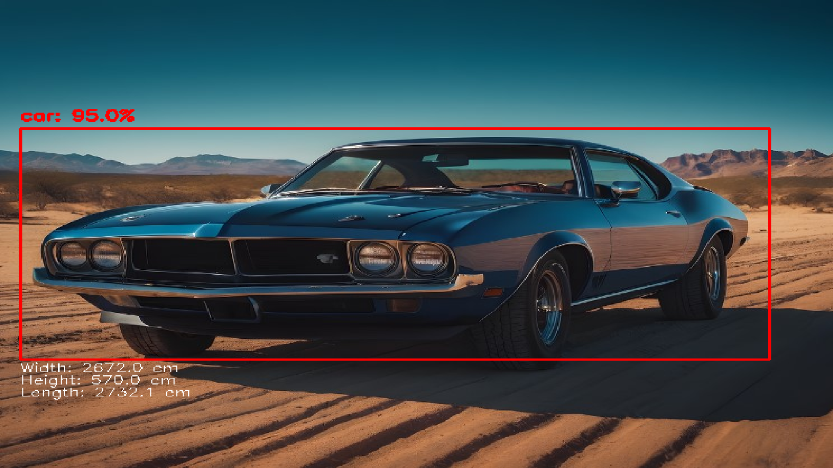
Image Detection Workflow
Load Image:
Use OpenCV to read the input image.
Preprocess Image:
Convert to a format suitable for YOLO model (blob).
Model Prediction:
Pass the processed image through YOLO to get detections.
Post-process Output:
Apply Non-Maximum Suppression (NMS) to filter overlapping boxes.
Annotate Results:
Draw bounding boxes, labels, and size information on the image.

Slide 8
Image detection (Output)

Slide 9
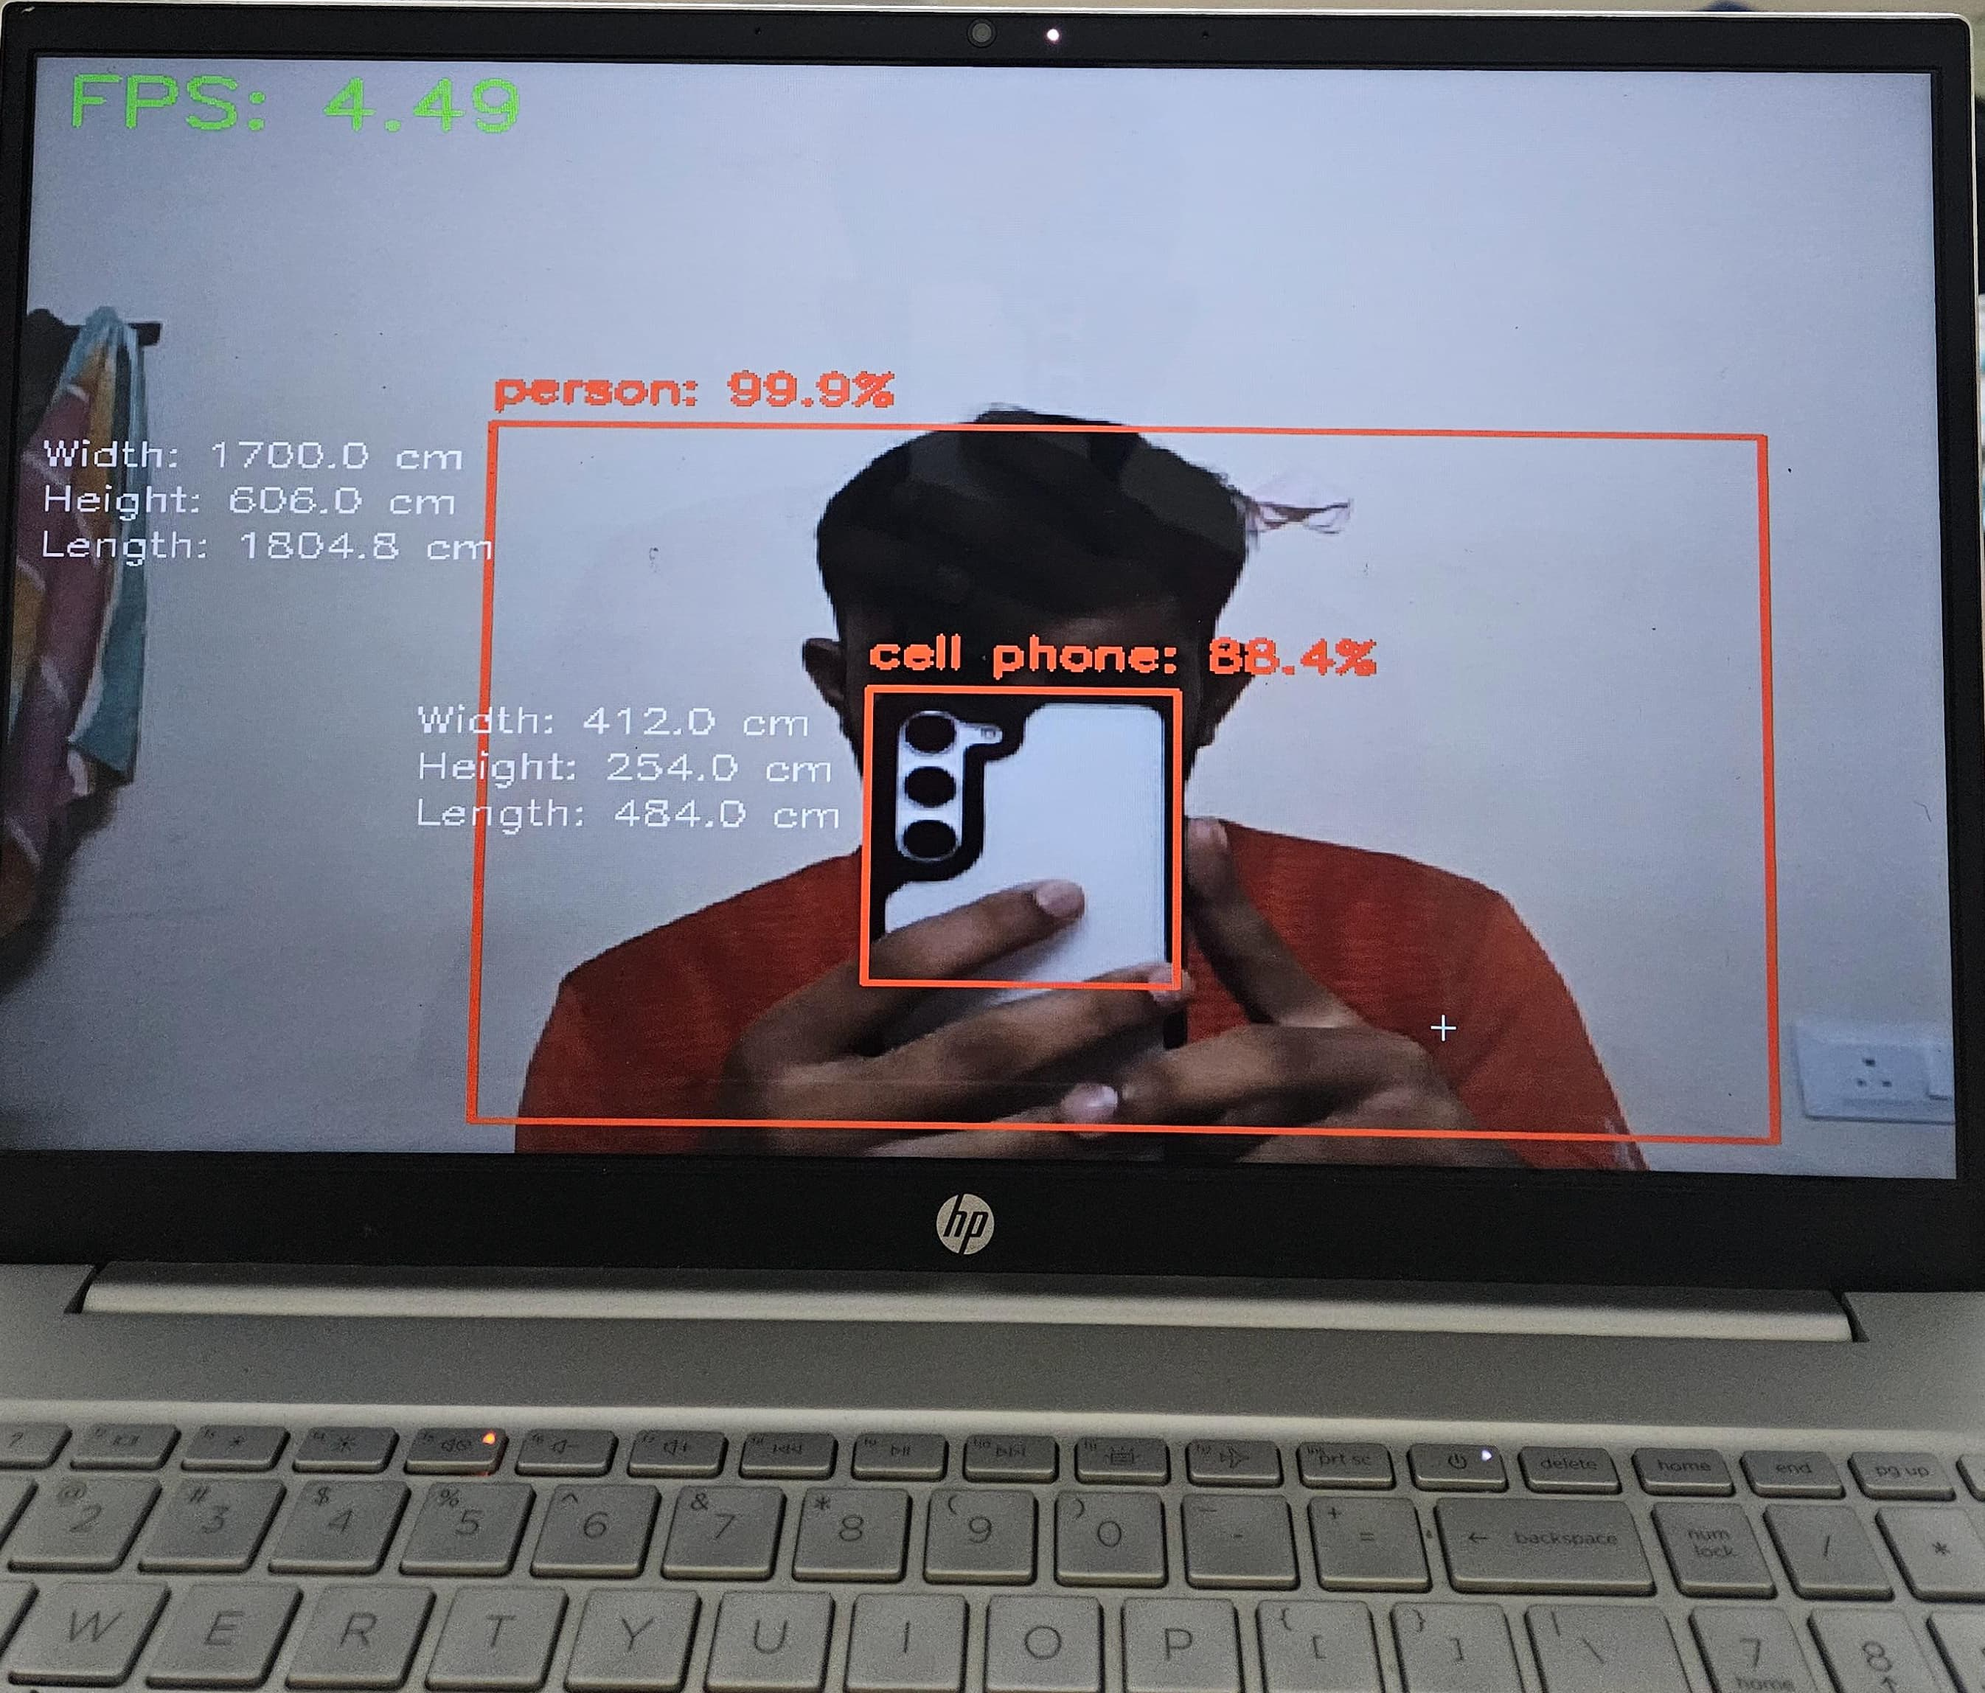
Real-Time Video Detection Workflow
Capture Video Stream:
Use a webcam to capture frames continuously.
Preprocess Frames:
Convert each frame to YOLO-compatible format.
Run Detection:
Pass frames through the YOLO model for predictions.
Annotate Frames:
Overlay bounding boxes, labels, size information, and FPS.
Zoom Functionality:
Allow zoom in and zoom out for better object visibility

Slide 10
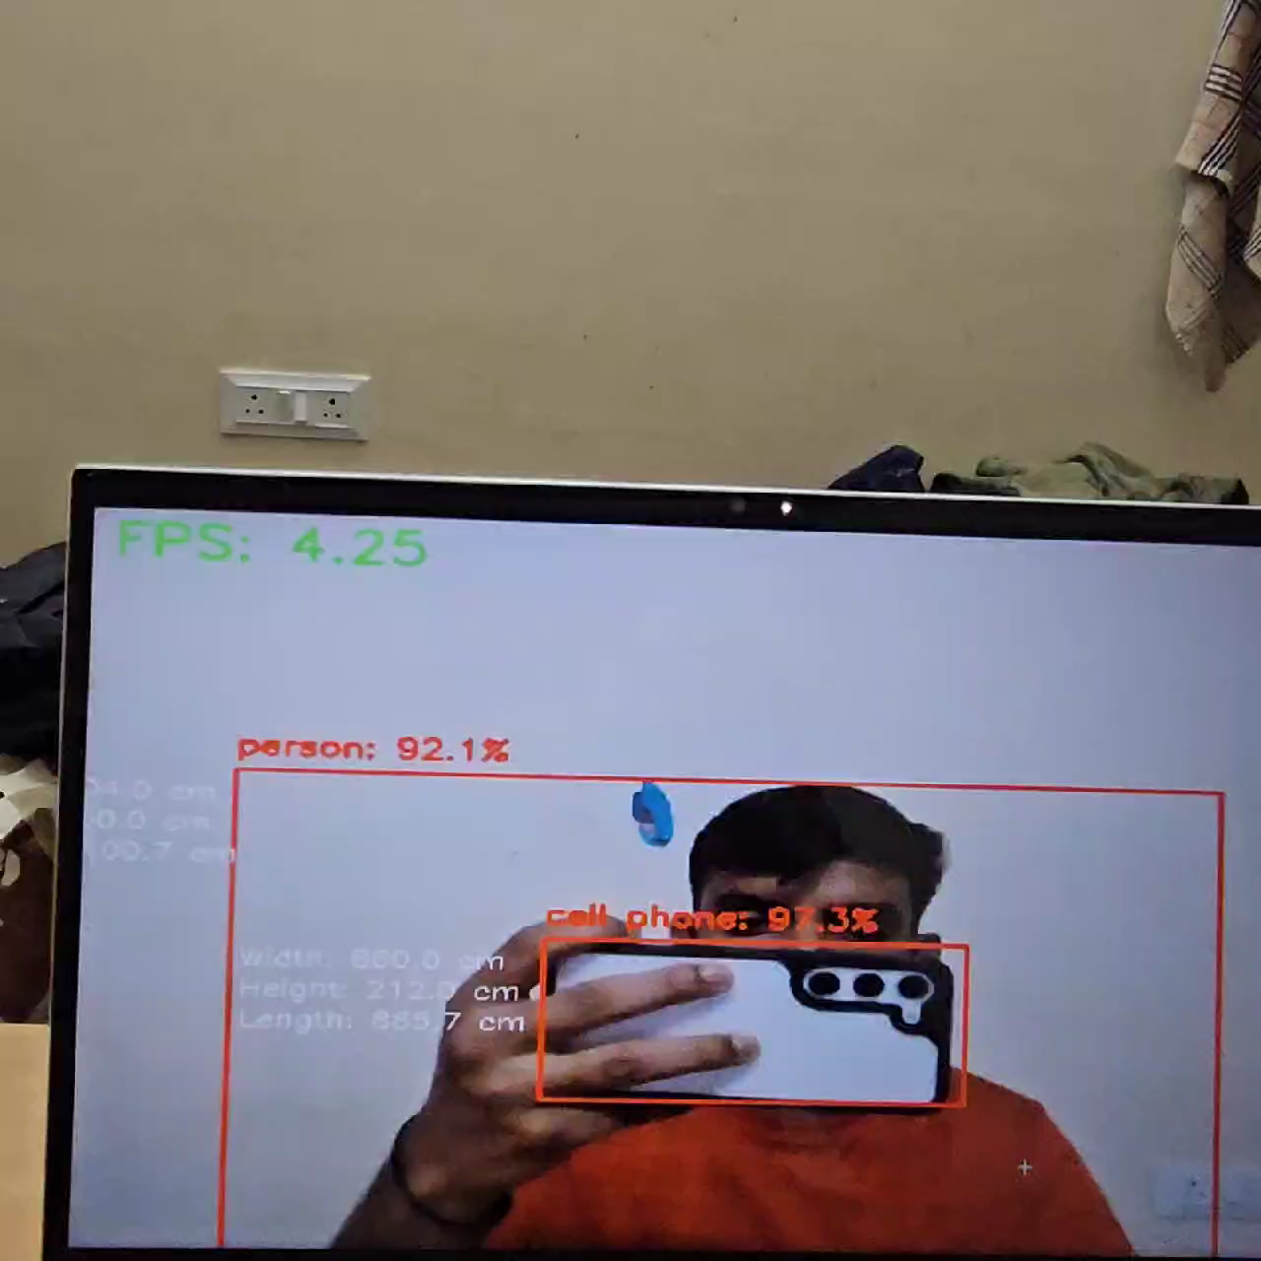
Real time video detection (output)

Slide 11
Data Model Used
COCO Dataset:
A large-scale dataset containing 80 object categories.
Provides a rich set of labeled images for training models.
YOLOv3 Pre-Trained Model:
Trained on the COCO dataset.
Offers a balance between accuracy and real-time performance.

Slide 12
Key Functions
1. Object Size Estimation:
Calculates real-world object dimensions using:
Pixel size of the bounding box.
Known object dimensions and distance.
Focal length of the camera.
Formula:
2. Model Loading:
cv2.dnn.readNet: Loads YOLO weights and configuration.
net.setInput: Sets the input for the YOLO model.

Slide 13
User Interactions in Video Mode
Press q to exit the real-time detection.
Press + to zoom in.
Press - to zoom out.
Annotations Include:
Object class and confidence.
Dimensions: Width, Height, Diagonal Length in cm.

Slide 14
3. Object Detection:
cv2.dnn.blobFromImage: Prepares the image for YOLO processing.
net.forward: Runs the YOLO model to generate predictions.
4. Post-Processing:
cv2.dnn.NMSBoxes: Filters overlapping bounding boxes to improve accuracy.
5. Video Processing:
cv2.VideoCapture: Captures live video from the webcam.
Zoom Functionality: Adjusts the frame size dynamically.

Slide 15
Challenges and Solutions
Challenges:
Handling overlapping object detections.
Real-time performance optimization.
Accurate size estimation.
Solutions:
Implemented Non-Maximum Suppression.
Used a pre-trained YOLO model for speed and accuracy.
Calibrated the camera for reliable size estimation.

Slide 16
Key Takeaways
Successfully implemented image and video detection.
Demonstrated accurate real-world size estimation.
In this project, we successfully implemented object detection system utilizing YOLO (You Only Look Once), a state-of-the-art model in computer vision. Our system demonstrated proficiency in detecting and annotating objects in both static images and real-time video feeds, with the additional capability to estimate real-world object dimensions.
Gained hands-on experience with advanced computer vision tools such as OpenCV and YOLO.
Understood the intricacies of model configurations, including weights, architecture, and class labels.
Enhanced problem-solving skills in applying theoretical concepts to practical scenarios.

